Slide 1

Notes:
Module x: Title
Course xxxxy
Presentation: xx minutes
Lab: xx minutes
This module helps students to ….
After completing this module, students will be able to:
Objective #1.
Objective #2.
Objective #3.
Required materials
To teach this module, you need the Microsoft Office PowerPoint® file xxxxy_xx.ppt.
Important It is recommended that you use PowerPoint 2002 or a later version to display the slides for this course. If you use PowerPoint Viewer or an earlier version of PowerPoint, all the features of the slides might not be displayed correctly.
Preparation tasks
To prepare for this module:
Read all of the materials for this module.
Practice performing the demonstrations and the lab exercises.
Work through the Module Review and Takeaways section and determine how you will use this
section to reinforce student learning and promote knowledge transfer to on-the-job performance.
If this is a KonaH product, use this section:
Make sure that students are aware that there are additional information and resources for the module on the Course Companion CD.
If this is a Forte product, use this section:
Make sure that students are aware that there are additional online resources for the module on the Course CD.

Slide 2
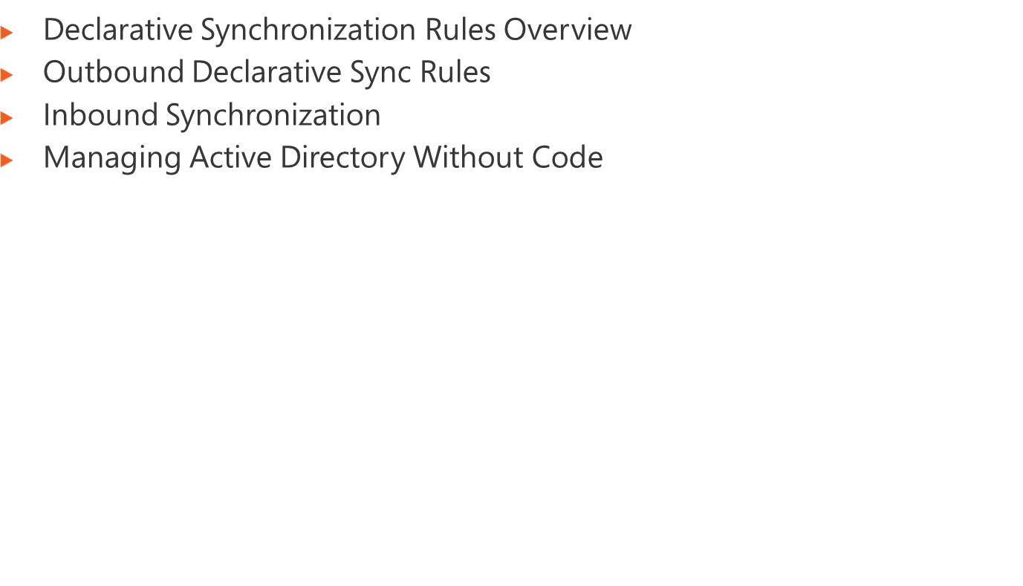
Notes:
Module x: Title
Course xxxxy

Slide 3

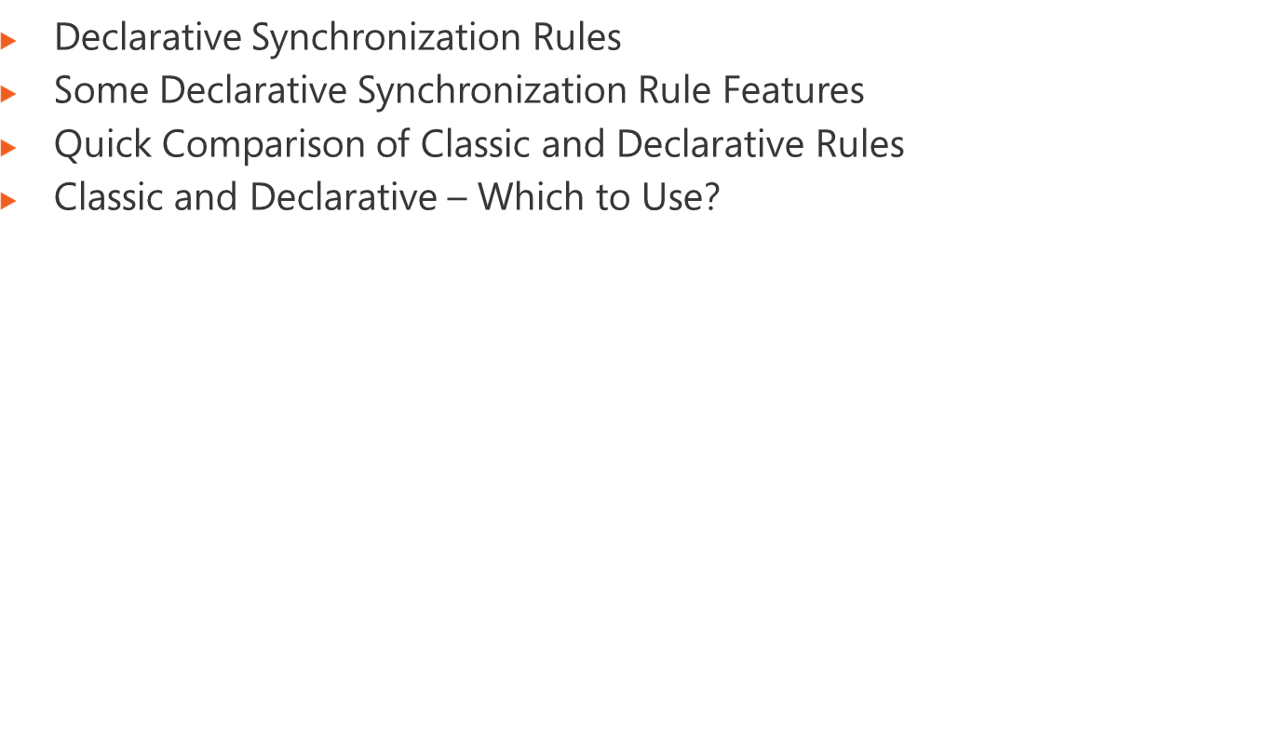
Notes:
Module x: Title
Course xxxxy

Slide 4
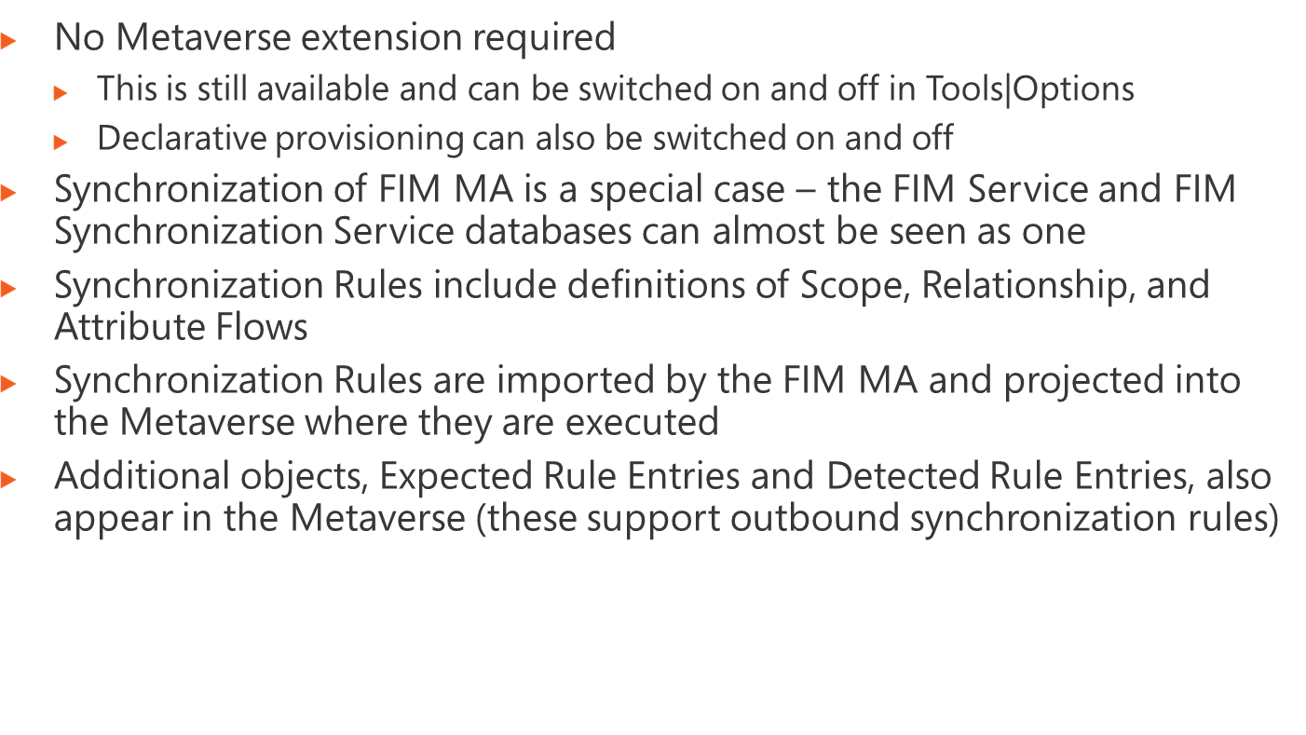
Notes:
Module 4: Managing Security
Course 2786B

Slide 5
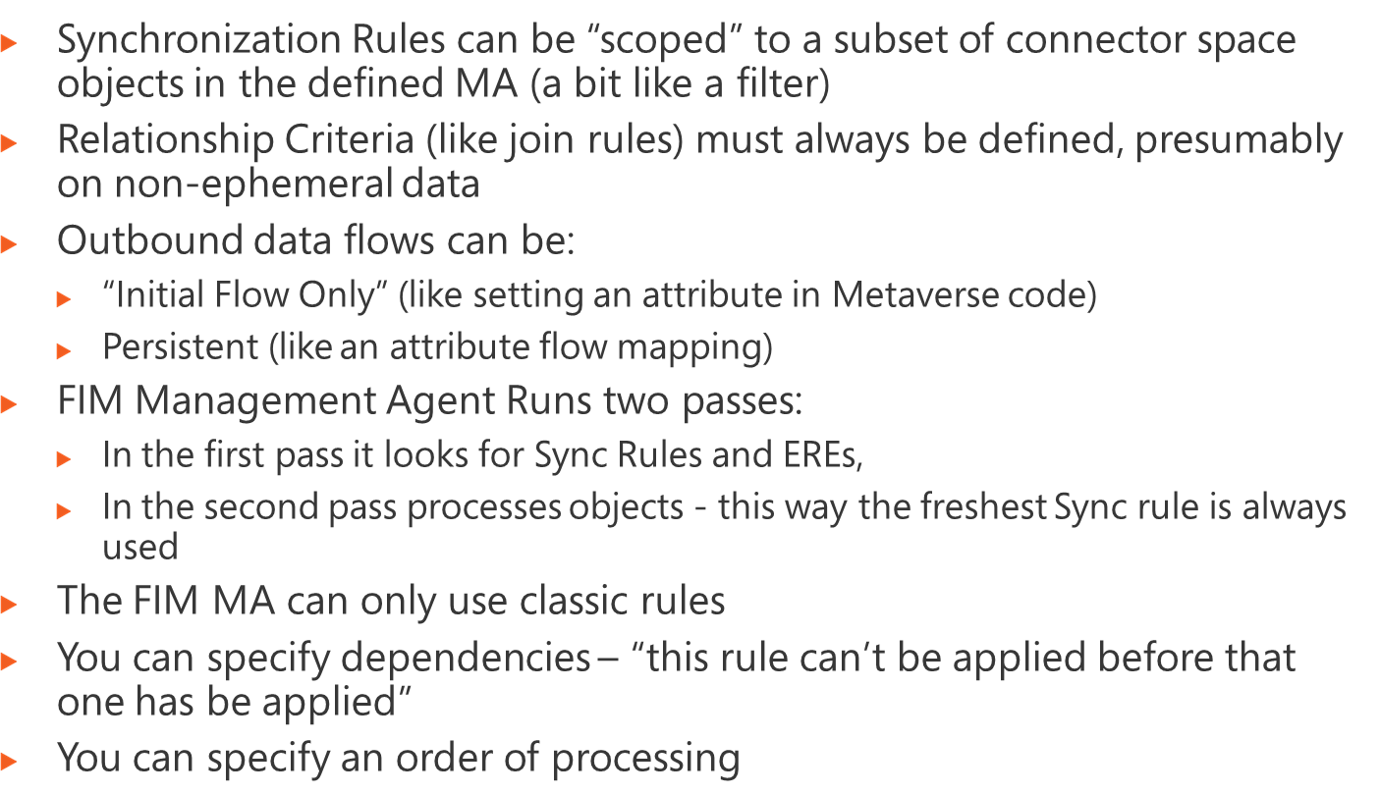
Notes:
Module 4: Managing Security
Course 2786B

Slide 6
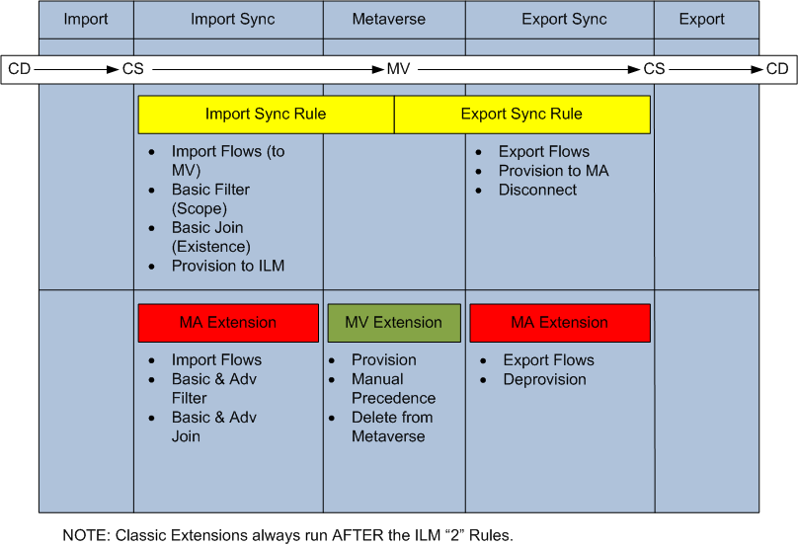
Import flows to MV
Scope (mapping of object types plus filter)
Relationship which includes simple join
Create in FIM
Initial and Persistent Export Flows from MV
Create in connected system
Disconnect
Declarative
Complex import flows to MV
Advanced filter which can disconnect
Advanced join and join resolution
Projection
Provision
Manual precedence
Metaverse deletion rule
Complex export flows
Deprovision logic
Classic
NOTE: Classic rules run AFTER the declarative rules
Notes:
Module 4: Managing Security
Course 2786B

Slide 7
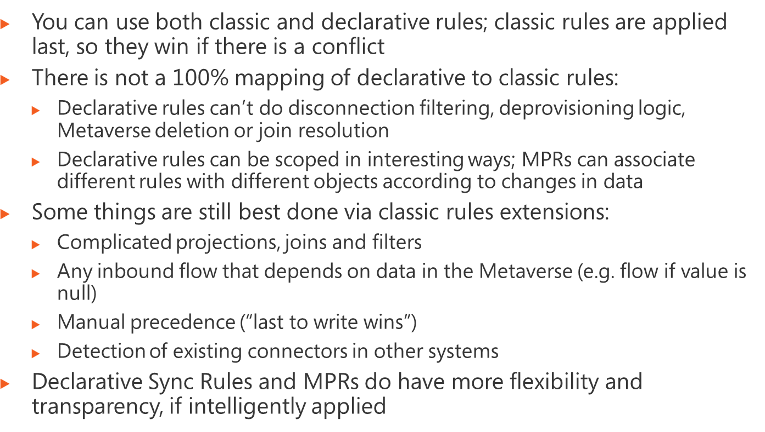
Notes:
Module 4: Managing Security
Course 2786B

Slide 8
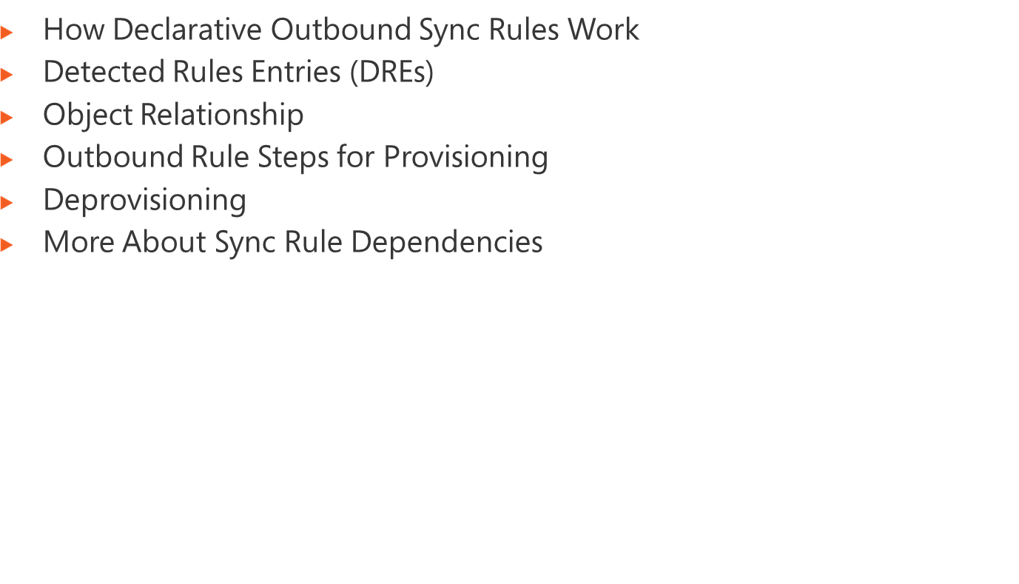
Notes:
Module x: Title
Course xxxxy

Slide 9








1
Portal
Database
ERE
ERE
ERE
3
5
2
4
ERE
MPR
Directory
6
7
Notes:
Module x: Title
Course xxxxy

Slide 10
Portal
Database
4
3
DRE
DRE
ERE
ERE
2
DRE
ERE
Directory
1
Notes:
Module x: Title
Course xxxxy

Slide 11
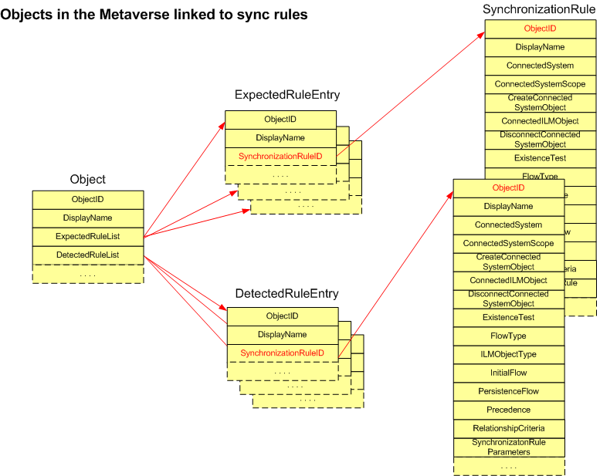
Notes:
Module 4: Managing Security
Course 2786B

Slide 12
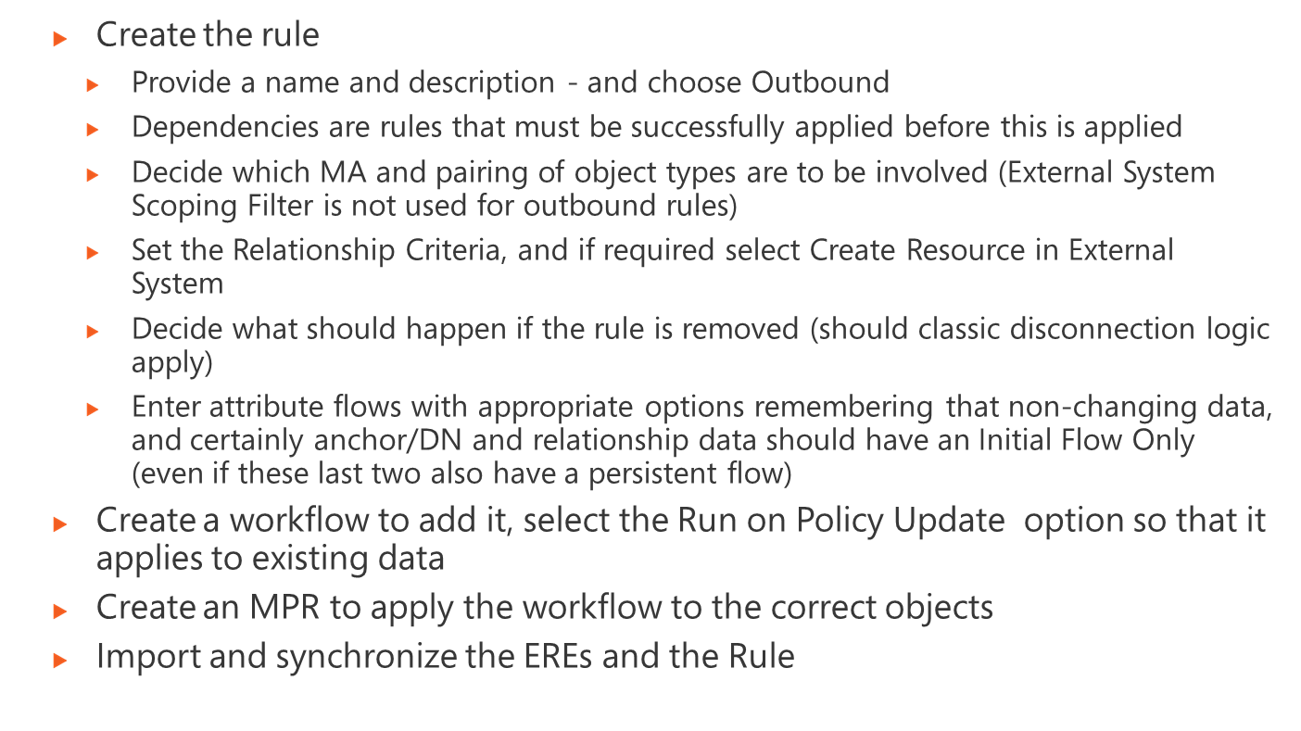
Notes:
Module 4: Managing Security
Course 2786B

Slide 13
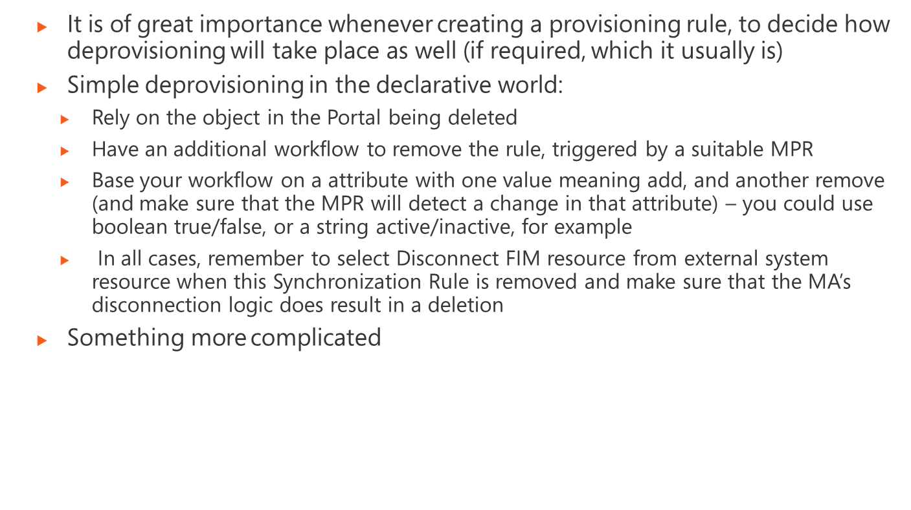
Notes:
Module 4: Managing Security
Course 2786B

Slide 14
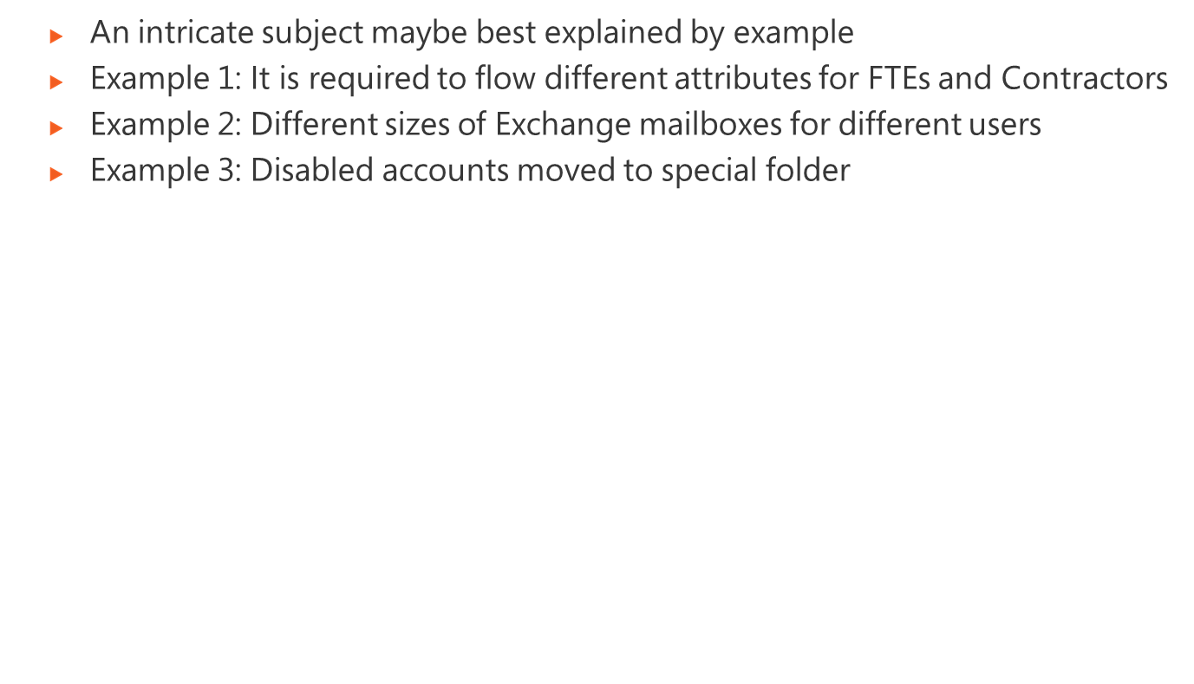
Notes:
Module 4: Managing Security
Course 2786B

Slide 15
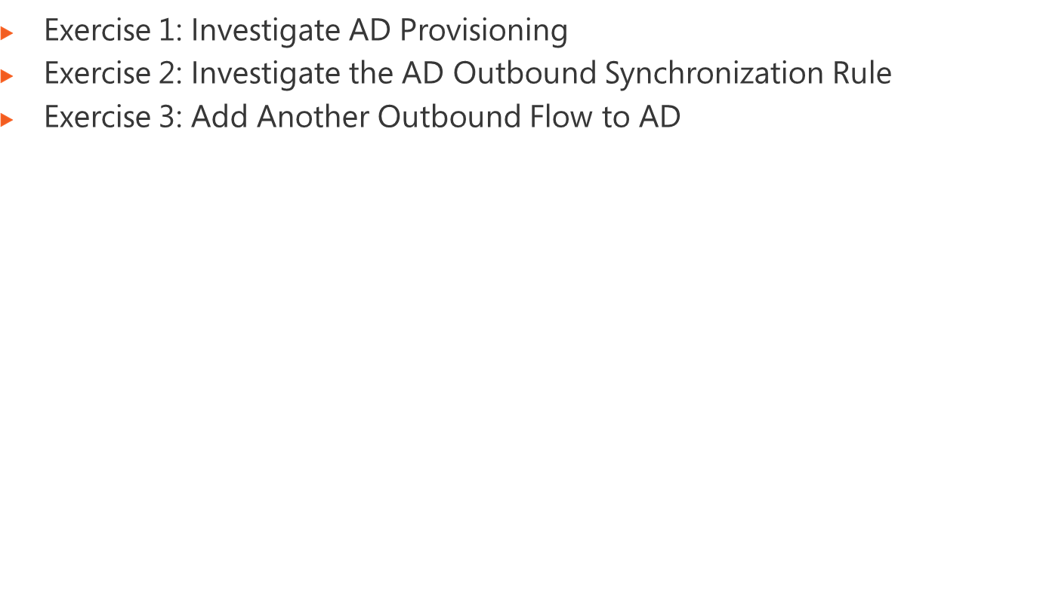
Logon information
Virtual machine | FIM2010RC1
User name | Administrator
Password | Pa$$w0rd
Estimated time: 45 minutes
Notes:
Module x: Title
Course xxxxy
In this lab, students will ….
Exercise 1
In this exercise, students ….
Exercise 2
In this exercise, students ….
Before the students begin the lab, read the scenario associated with each exercise to the class. This will reinforce the broad issue that the students are troubleshooting and will help to facilitate the lab discussion at the end of the module. Remind the students to complete the discussion questions after the last lab exercise.
If this is a KonaH product, use this note:
Note: The lab exercise answer keys are provided on the Course Companion CD. To access the answer key, click the link located at the bottom of the relevant lab exercise page.
If this is a Forte product, use this note:
Note: The lab exercise answer keys are provided on the Course CD.

Slide 16
Notes:
Module x: Title
Course xxxxy
Use the questions on the slide to guide the debriefing after students have completed the lab exercises.

Slide 17
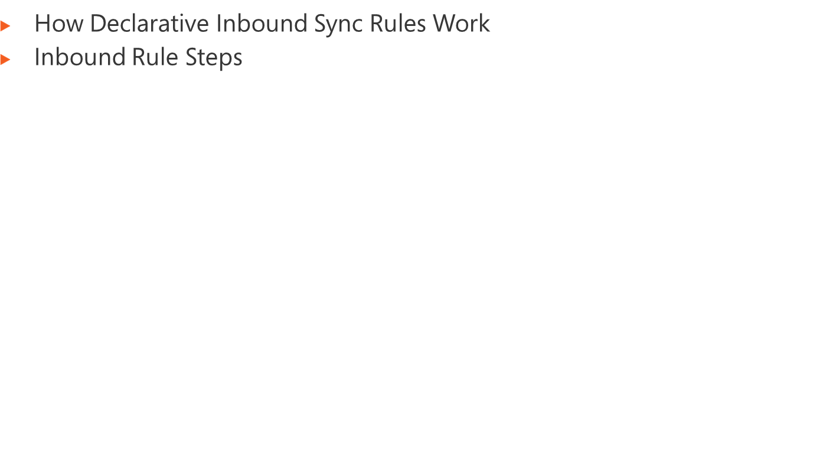
Notes:
Module x: Title
Course xxxxy

Slide 18








1
2
3
Portal
Database
4
ERE
ERE
ERE
ERE
MPR
Directory
Notes:
Module x: Title
Course xxxxy

Slide 19
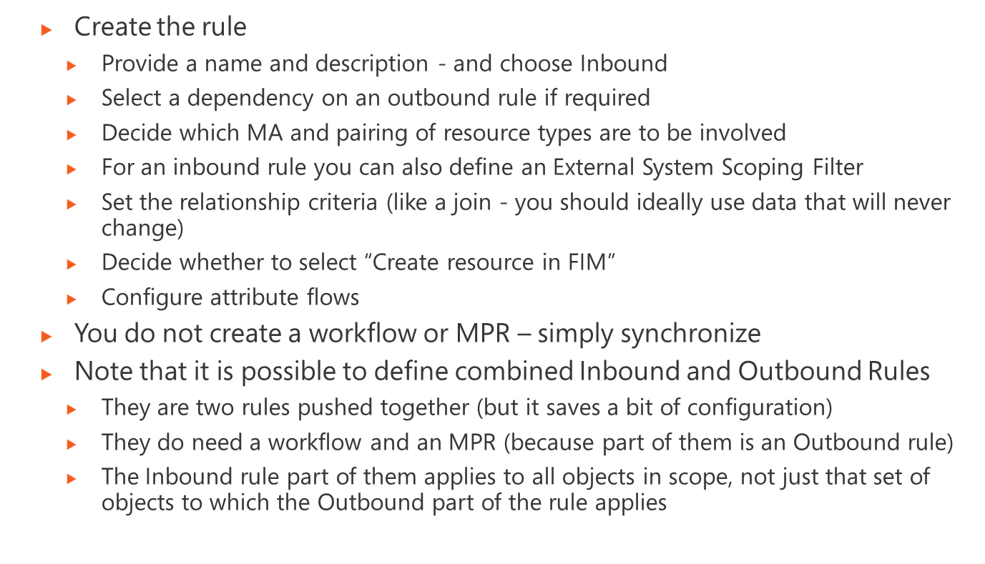
Notes:
Module 4: Managing Security
Course 2786B

Slide 20
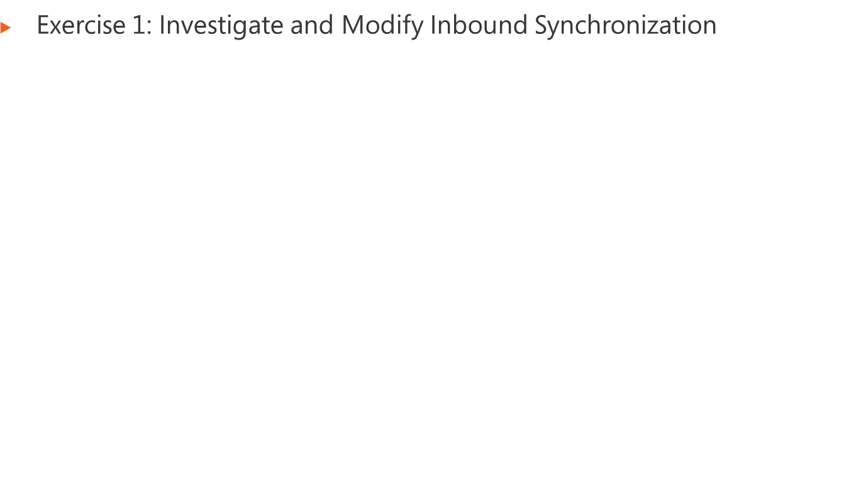
Logon information
Virtual machine | FIM2010RC1
User name | Administrator
Password | Pa$$w0rd
Estimated time: 75 minutes
Notes:
Module x: Title
Course xxxxy
In this lab, students will ….
Exercise 1
In this exercise, students ….
Exercise 2
In this exercise, students ….
Before the students begin the lab, read the scenario associated with each exercise to the class. This will reinforce the broad issue that the students are troubleshooting and will help to facilitate the lab discussion at the end of the module. Remind the students to complete the discussion questions after the last lab exercise.
If this is a KonaH product, use this note:
Note: The lab exercise answer keys are provided on the Course Companion CD. To access the answer key, click the link located at the bottom of the relevant lab exercise page.
If this is a Forte product, use this note:
Note: The lab exercise answer keys are provided on the Course CD.

Slide 21
Notes:
Module x: Title
Course xxxxy
Use the questions on the slide to guide the debriefing after students have completed the lab exercises.

Slide 22
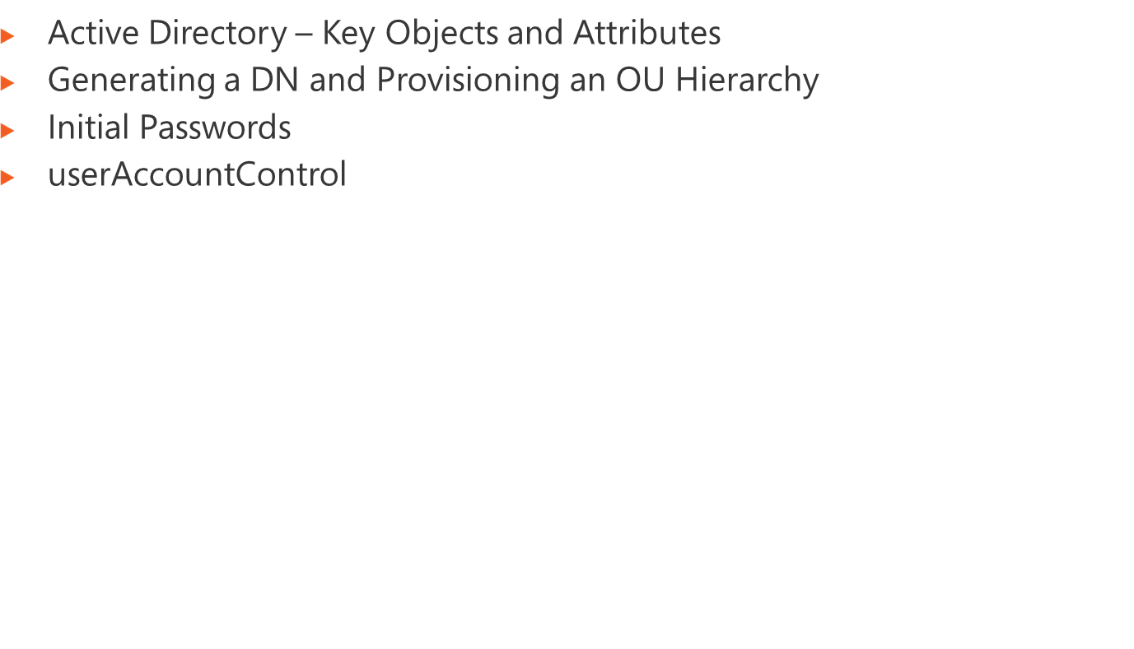
Notes:
Module x: Title
Course xxxxy

Slide 23
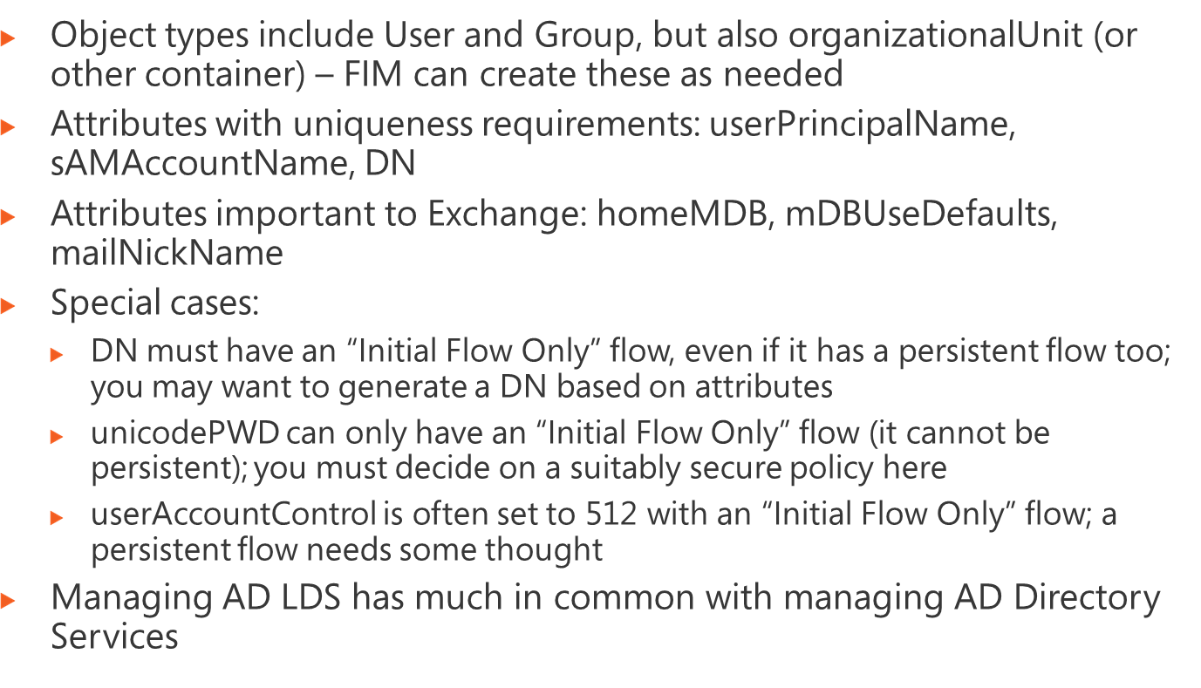
Notes:
Module x: Title
Course xxxxy

Slide 24
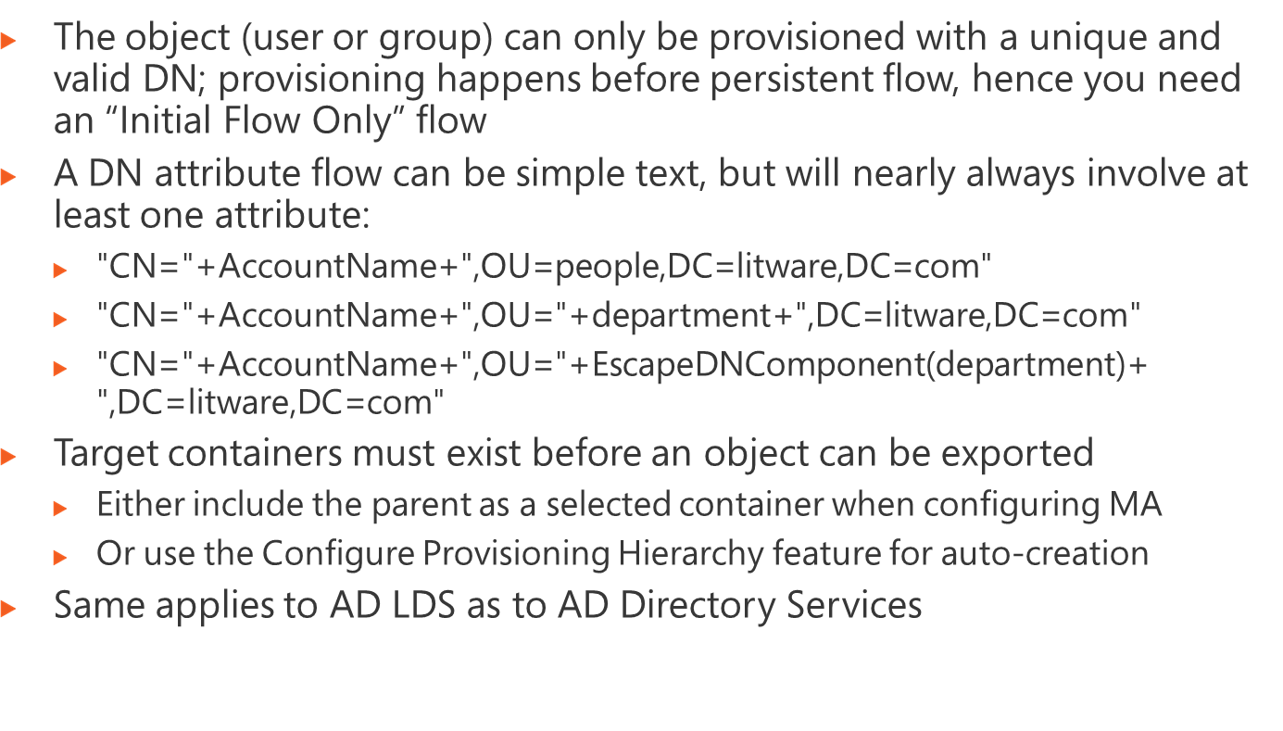
Notes:
Module x: Title
Course xxxxy

Slide 25
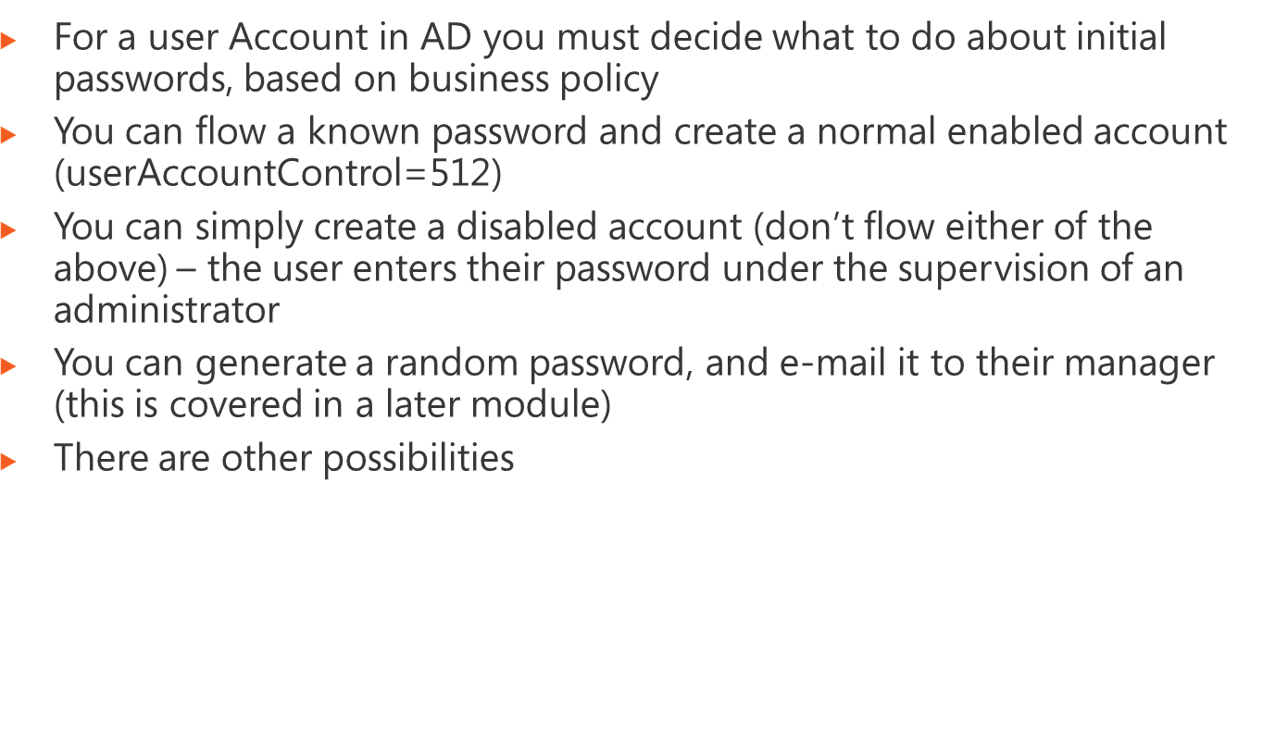
Notes:
Module x: Title
Course xxxxy

Slide 26
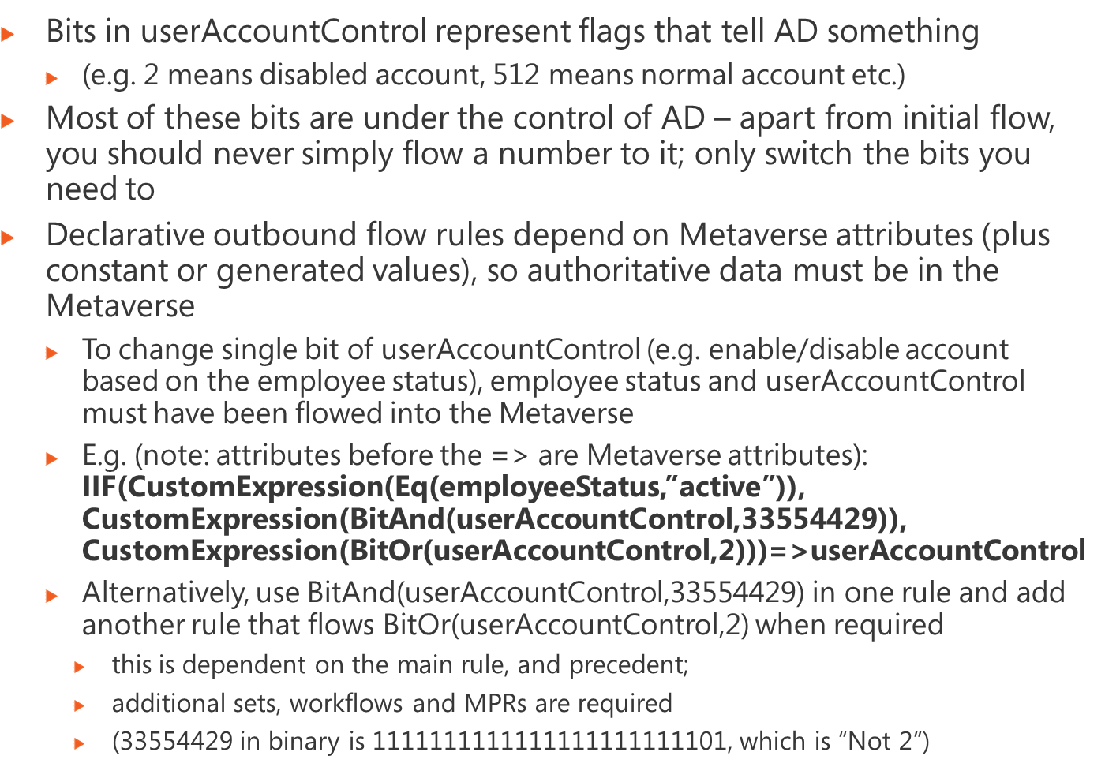
Notes:
Module x: Title
Course xxxxy

Slide 27
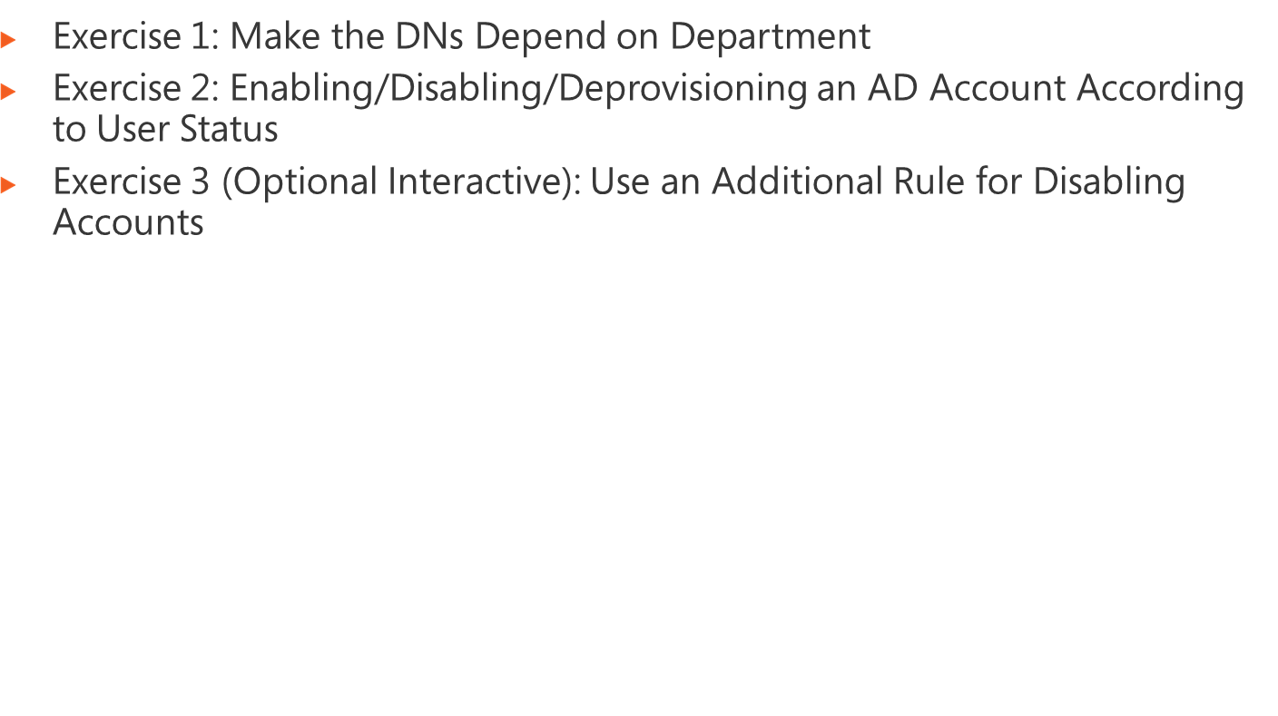
Logon information
Virtual machine | FIM2010RC1
User name | Administrator
Password | Pa$$w0rd
Estimated time: 60 minutes (plus optional exercise)
Notes:
Module x: Title
Course xxxxy
In this lab, students will ….
Exercise 1
In this exercise, students ….
Exercise 2
In this exercise, students ….
Before the students begin the lab, read the scenario associated with each exercise to the class. This will reinforce the broad issue that the students are troubleshooting and will help to facilitate the lab discussion at the end of the module. Remind the students to complete the discussion questions after the last lab exercise.
If this is a KonaH product, use this note:
Note: The lab exercise answer keys are provided on the Course Companion CD. To access the answer key, click the link located at the bottom of the relevant lab exercise page.
If this is a Forte product, use this note:
Note: The lab exercise answer keys are provided on the Course CD.

Slide 28
Notes:
Module x: Title
Course xxxxy
Use the questions on the slide to guide the debriefing after students have completed the lab exercises.

Slide 29
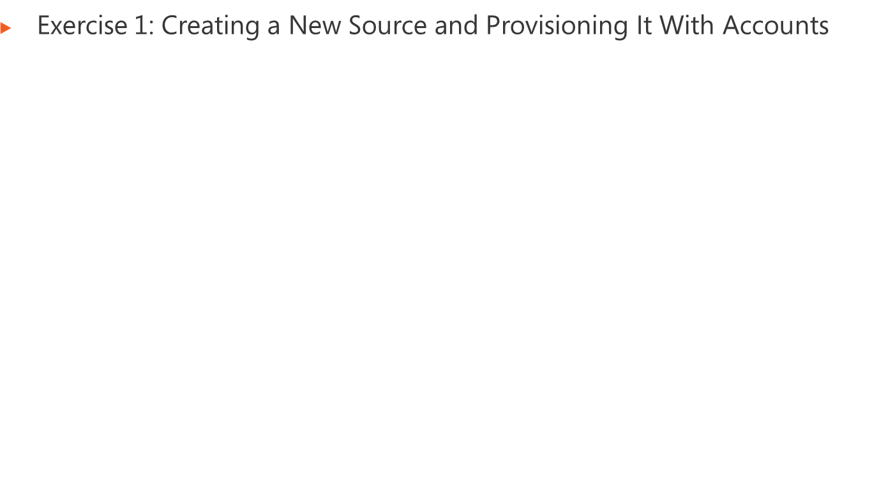
Logon information
Virtual machine | FIM2010RC1
User name | Administrator
Password | Pa$$w0rd
Estimated time: 45 minutes
Notes:
Module x: Title
Course xxxxy
In this lab, students will ….
Exercise 1
In this exercise, students ….
Exercise 2
In this exercise, students ….
Before the students begin the lab, read the scenario associated with each exercise to the class. This will reinforce the broad issue that the students are troubleshooting and will help to facilitate the lab discussion at the end of the module. Remind the students to complete the discussion questions after the last lab exercise.
If this is a KonaH product, use this note:
Note: The lab exercise answer keys are provided on the Course Companion CD. To access the answer key, click the link located at the bottom of the relevant lab exercise page.
If this is a Forte product, use this note:
Note: The lab exercise answer keys are provided on the Course CD.

Slide 30
Notes:
Module x: Title
Course xxxxy
Use the questions on the slide to guide the debriefing after students have completed the lab exercises.

Slide 31
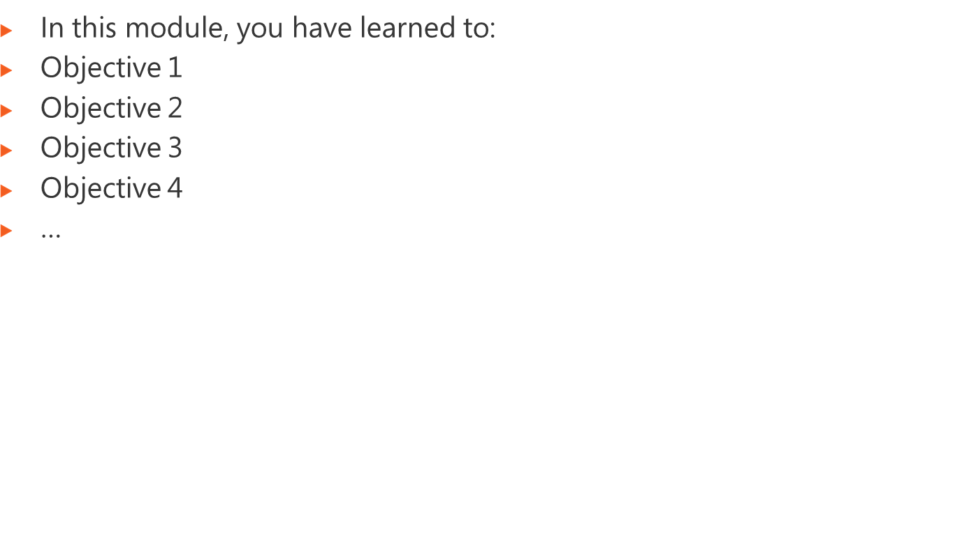
Notes:
Module x: Title
Course xxxxy

Slide 32
Notes:
Module x: Title
Course xxxxy
Review Questions
Point the students to the appropriate section in the course so that they are able to answer the questions presented in this section.
Common Issues Related to Desktop Application Support
Point the students to possible troubleshooting tips for the issues presented in this section.
Real-world Issues and Scenarios
You can either discuss possible solutions for the scenarios at the end of the module or assign these scenarios as homework for the students. If you assign the scenarios as homework, you should provide some high-level hints that might help the students solve the problem stated in the scenarios. You can also do a follow-up debriefing the following day on some of the scenarios that have been assigned as homework to students.
You can create high-level hints for each scenario by using the following possible solutions for the scenarios.
Scenario 1.
Solution 1.
Scenario 2.
Solution 2.
Scenario 3.
Solution 3.
Best Practices for Supporting Users Running Applications on Windows XP
Help the students understand the best practices presented in this section. Ask students to consider these best practices in the context of their own business situations.
Tools
Point out the location from which each key tool can be installed. Let students review the function and usage of each tool on their own. Remind students that they can use this as a master list to help them gather all the tools required to facilitate their application support work.

